Slide 1
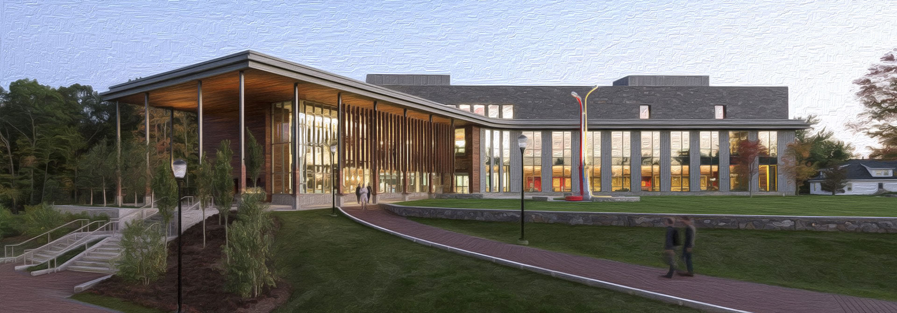
CS 250 Final Project
August 2024
CS250 Agile Presentation
Vanessa Torres

Slide 2

CS 250 Final Project
August 2024
Agenda
Introduction to Scrum-Agile Methodology
Roles in a Scrum-Agile Team
Agile Phases in the SDLC
Describing Waterfall Model
Waterfall vs. Agile
Questions
References

Slide 3
CS 250 Final Project
August 2024
Introduction to Scrum-agile
Why Agile for SNHU Travel?
Scrum is a method to getting work done on a team, “with continuous experimentation and feedback loops along the way to learn and improve as you go. Scrum helps people and teams deliver value incrementally in a collaborative way” (Scrum.org, n.d.)
The SNHU Travel project involved regular adjustments driven by changing requirements and client feedback. Thanks to Agile’s iterative approach, the development team was able to adapt swiftly, keeping the product in alignment with our business goals.

Slide 4




CS 250 Final Project
August 2024
Roles on a Scrum-agile Team
Scrum Master
Product Owner
Responsible for ensuring Scrum is understood and enacted by ensuring that the Scrum Team adheres to Scrum theory, practices, and rules. (Cobb, 2015, p. 36). The Scrum Master prioritizes thorough planning, effective communication, clarity of roles, and proactive gathering of feedback.
Responsible for defining and maintaining the product backlog and ensures the team delivers value aligned with business needs. (Cobb, 2015, p. 68). The SNHU Travel PO wrote the user stories, created the story maps, and defined the acceptance criteria for the SNHU travel booking software.
Developer
Product Tester
The developer works to refine the final product in the agile software development process. Working with the rest of the project team, the developer works directly to pull more detail as needed to fill the requirements (Cobb, 2015, p. 181).
Ensures quality through continuous testing, identifying issues early in the development cycle. The SNHU Travel Tester expanded on the product backlog and on the acceptance criteria from the user stories.

Slide 5
CS 250 Final Project
August 2024
Agile Phases in the SDLC
Requirement Analysis
Feasibility Study
Design
SNHU Travel identified key features like booking management, customer profiles, and mobile app. The Agile approach allowed continuous refinement of these requirements as the project evolved.
SNHU Travel ensured that the proposed features could be implemented to stakeholder and executive leaders’ requirements and as well as time and budget constraints.
For SNHU Travel, this phase focused on designing a user-friendly booking system and backend structure. In Agile, the design was flexible, allowing adjustments based on ongoing feedback.
Coding
Testing
Installation/ Deployment
The SNHU Travel developers coded the travel booking application based on technical requirements.
The SNHU Travel Product Testers ensure that the software functions correctly and meets the specified requirements.
The SNHU Travel team delivered its final product, ensuring it was operational for customer use.
(Bennett, 2024)

Slide 6
CS 250 Final Project
August 2024
Describing Waterfall Model
The Waterfall model is the earliest SDLC approach that was used for software development (SDLC - Waterfall Model, n.d.). According to Cobb (2015), the waterfall method is analogous to how a waterfall is formed in nature, when water falls off a cliff. In this model, the phases are distinct and don’t overlap. The waterfall model shows us the software development process as a straightforward linear sequence.
This indicates that each phase of development starts only after the previous one has been complete.(SDLC - Waterfall Model, n.d.). The disadvantage of waterfall development is that it does not allow much reflection or revision. (Cobb, 2015, p. 384).
Waterfall Approach: If we had used the Waterfall method for the SNHU Travel project, it would have been quite a structured process, leaving little flexibility for changes once we finished the initial planning phase.

Slide 7
CS 250 Final Project
August 2024
Waterfall or Agile Approach?
I believe that the Scrum-agile approach was best for the SNHU Travel development project, as it allowed the team to adapt to the changes to the market needs easily via the Agile-scrum approach.
In contrast, the typical waterfall approach has well-defined requirements up front (Cobb, 2015, p. 262) and the project is designed, developed and tested sequentially (Cobb, 2015, p. 264).
If the SNHU Travel Project team follows the waterfall approach, they might find themselves needing to rework certain aspects of the project, which could lead to significant time delays and increased costs, ultimately impacting the overall success of the travel project.

Slide 8



Questions?
Presentation by Vanessa Torres
https://github.com/torresvanessa
vanessa.torres5@snhu.edu

Slide 9
References
Bennett, L. (2024, August 13). Software Development Life Cycle (SDLC) phases & models. Guru99. https://www.guru99.com/software-development-life-cycle-tutorial.html
Cobb, C. G. (2015). The Project Manager’s Guide to Mastering Agile: Principles and Practices for an Adaptive Approach. John Wiley & Sons.
SDLC - Waterfall model. (n.d.). https://www.tutorialspoint.com/sdlc/sdlc_waterfall_model.htm
What is Scrum? (n.d.). Scrum.org. https://www.scrum.org/learning-series/what-is-scrum/
‌

Slide 10

Credits
This presentation template is free for everyone to use thanks to the following:
for the presentation template
Pexels, Pixabay
for the photos
HAPPY DESIGNING!

